Slide 1

PROTESTS
A Data Science Approach
Group Project 5, DSI Cohort #1019
Group Members:
Stephen Strawbridge
Nicholas Kovacs
Young Park
Chris Burger
Notes:
Welcome to our presentation
We assume our audience here today are various union groups/protest groups, and our group presenting are acting as union group consultants.

Slide 2
Presentation Contents
Problem Statement/Background
Data Organization/Engineering
Exploratory Data Analysis (EDA)
Models Used
Conclusion/Recommendations

Slide 3

Problem Statement
Protests groups are not reaching full potential
Use prediction models to guess government response with reasonable confidence
Notes:
Problem Statement: We hypothesize that protest groups are not reaching their full potential in executing successful protests. This project aims to use various prediction models to find features of the most successful protests (based on government response) for each geographical region around the world.

Slide 4

Background
Data Source - Mass Mobilization Dataset
Data Features - demands, responses, location, brief notes on each protest, etc
Notes:
Data source used for our research is mass mobilization data from Binghamton University
Data covers 162 countries between 1990 and 2019; however because we had a vast amount of data, we focused our model on all data since 2000
Our main predictor features seen in the dataframe include country, number of participants, length in days of protest, various protestor demands, and perhaps most interestingly, brief notes on each protest (of which most were around 500 characters, so it was a sufficient length).
Finally the dataset included our target feature, the government response to each of the protests

Slide 5

Data Organization & Engineering
Key points
Engineer protest length feature
Dummify protester demands and government responses
Quantitative vs Qualitative (notes) features
Notes:
For protest length, duration in length was not actually given, but rather start days and end days, start months and end months, and finally start years and end years. Basic arithmetic was used to calculate length in days, the standard metric for all the data.
Protestor demands varied somewhat widley, with over a dozen different types of demands. Each demand was dummified so it could be quantitatively measured in our models.
The 7 different government responses were dummified as well, to be used as target features.
We also considered how our modeling would be using quantitative features, but would also need to incorporate our qualitative feature (the ‘protest notes’ feature) using NLP and transformation. This was a key consideration as we moved forward.

Slide 6
Data Organization & Engineering (cont.)
Our *7 target variables - gov. responses
Ignore
Accomodation
Arrests
Beatings
5. Crowd dispersal
6. Killings
7. Shootings
*...Or consolidate target variables
Notes:
For presentation purposes, our 7 target variables are listed above
A crucial realization we had was the fact that our baseline scores for predicting some of the above features was going to be difficult (specifically, the most drastic and violent responses). This is due to the fact that in essentially every country, killings and shootings, for example, are relatively rare, so predicting above the null model would be challenging.

Slide 7
Data Organization & Engineering (cont.)
Our *4 consolidated variables
Ignore
Accomodation
Adverse Reaction (arrests, crowd dispersal)
State Violence (beatings, shootings, killings)
Notes:
4 target variables CONSOLIDATED are listed above
We consolidate because these groupings are still significant for your purposes, and gives us lower baseline scores to beat.
For example, it may not be worth it to build a model to distinguish between shootings/killings, as the magnitude of these two outcomes are both very severe.

Slide 8
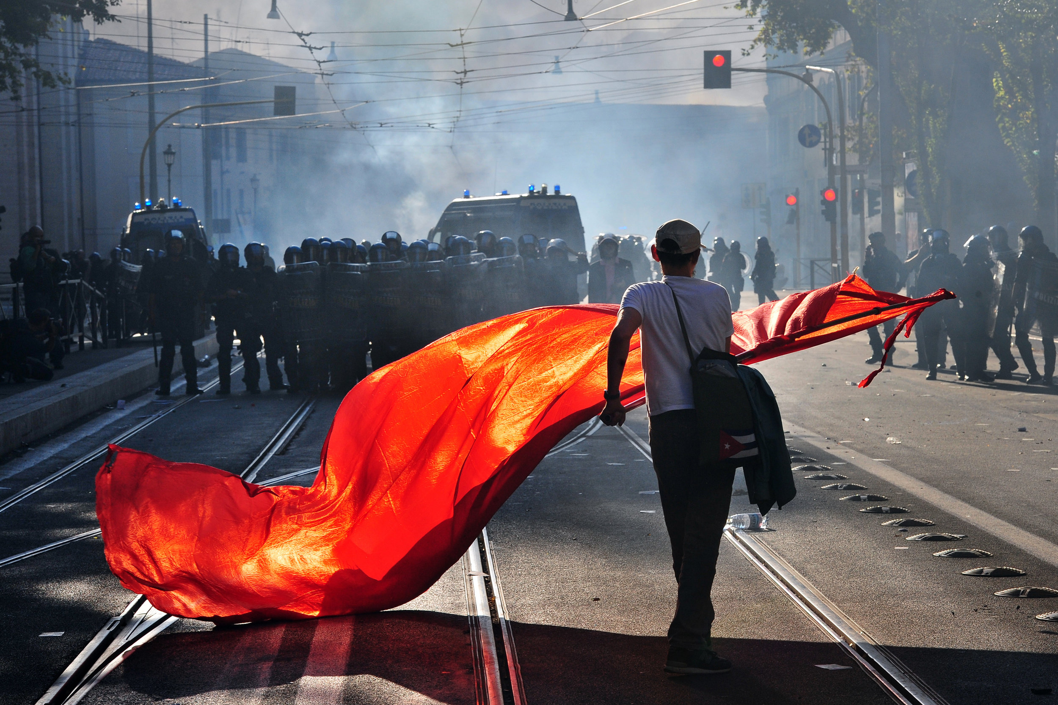
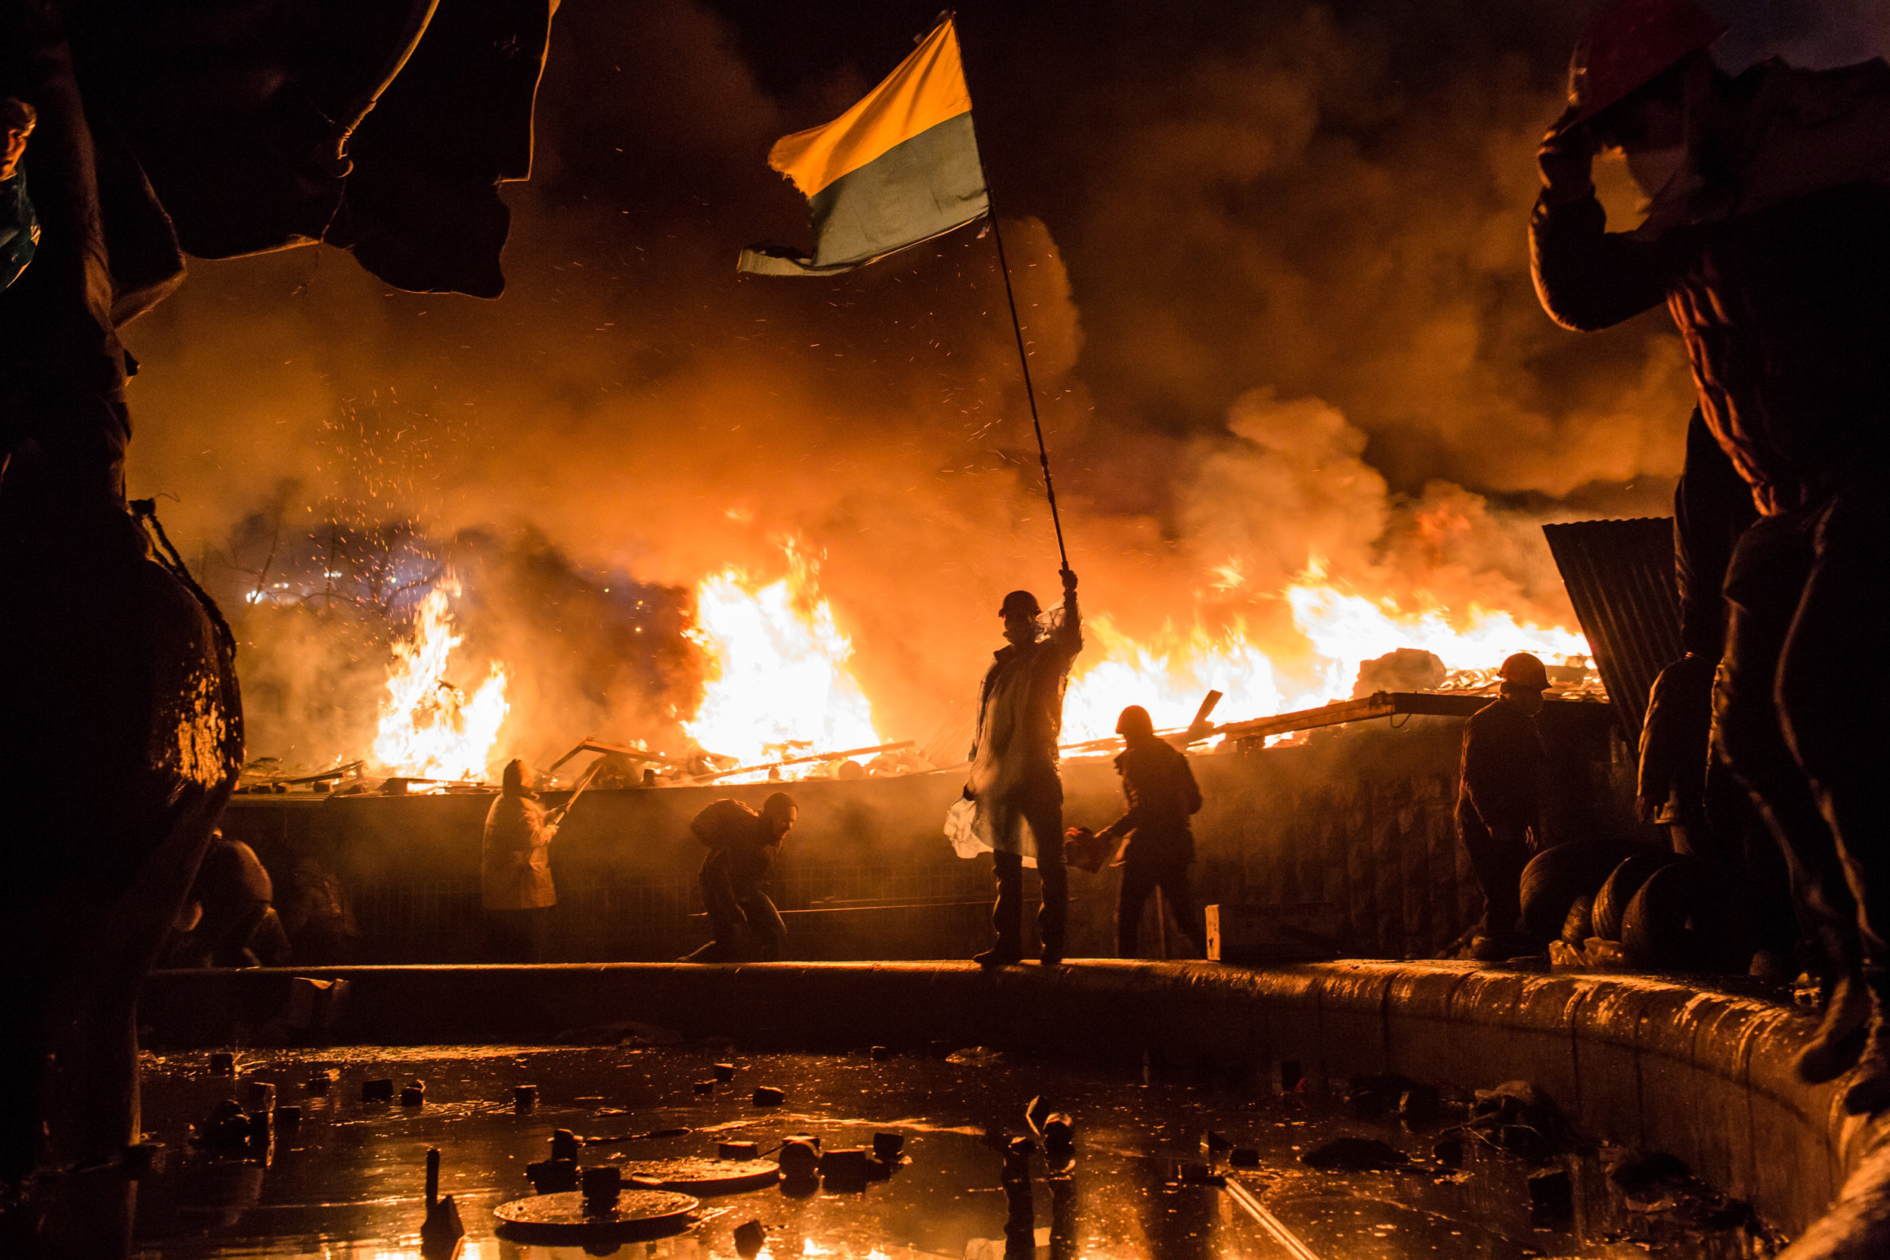
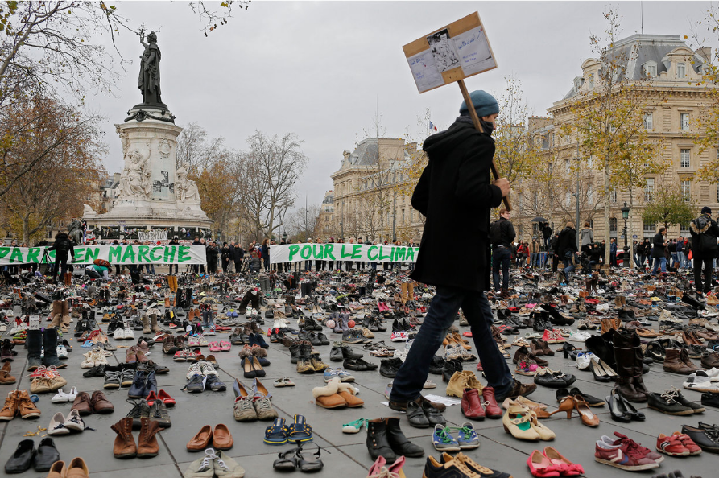
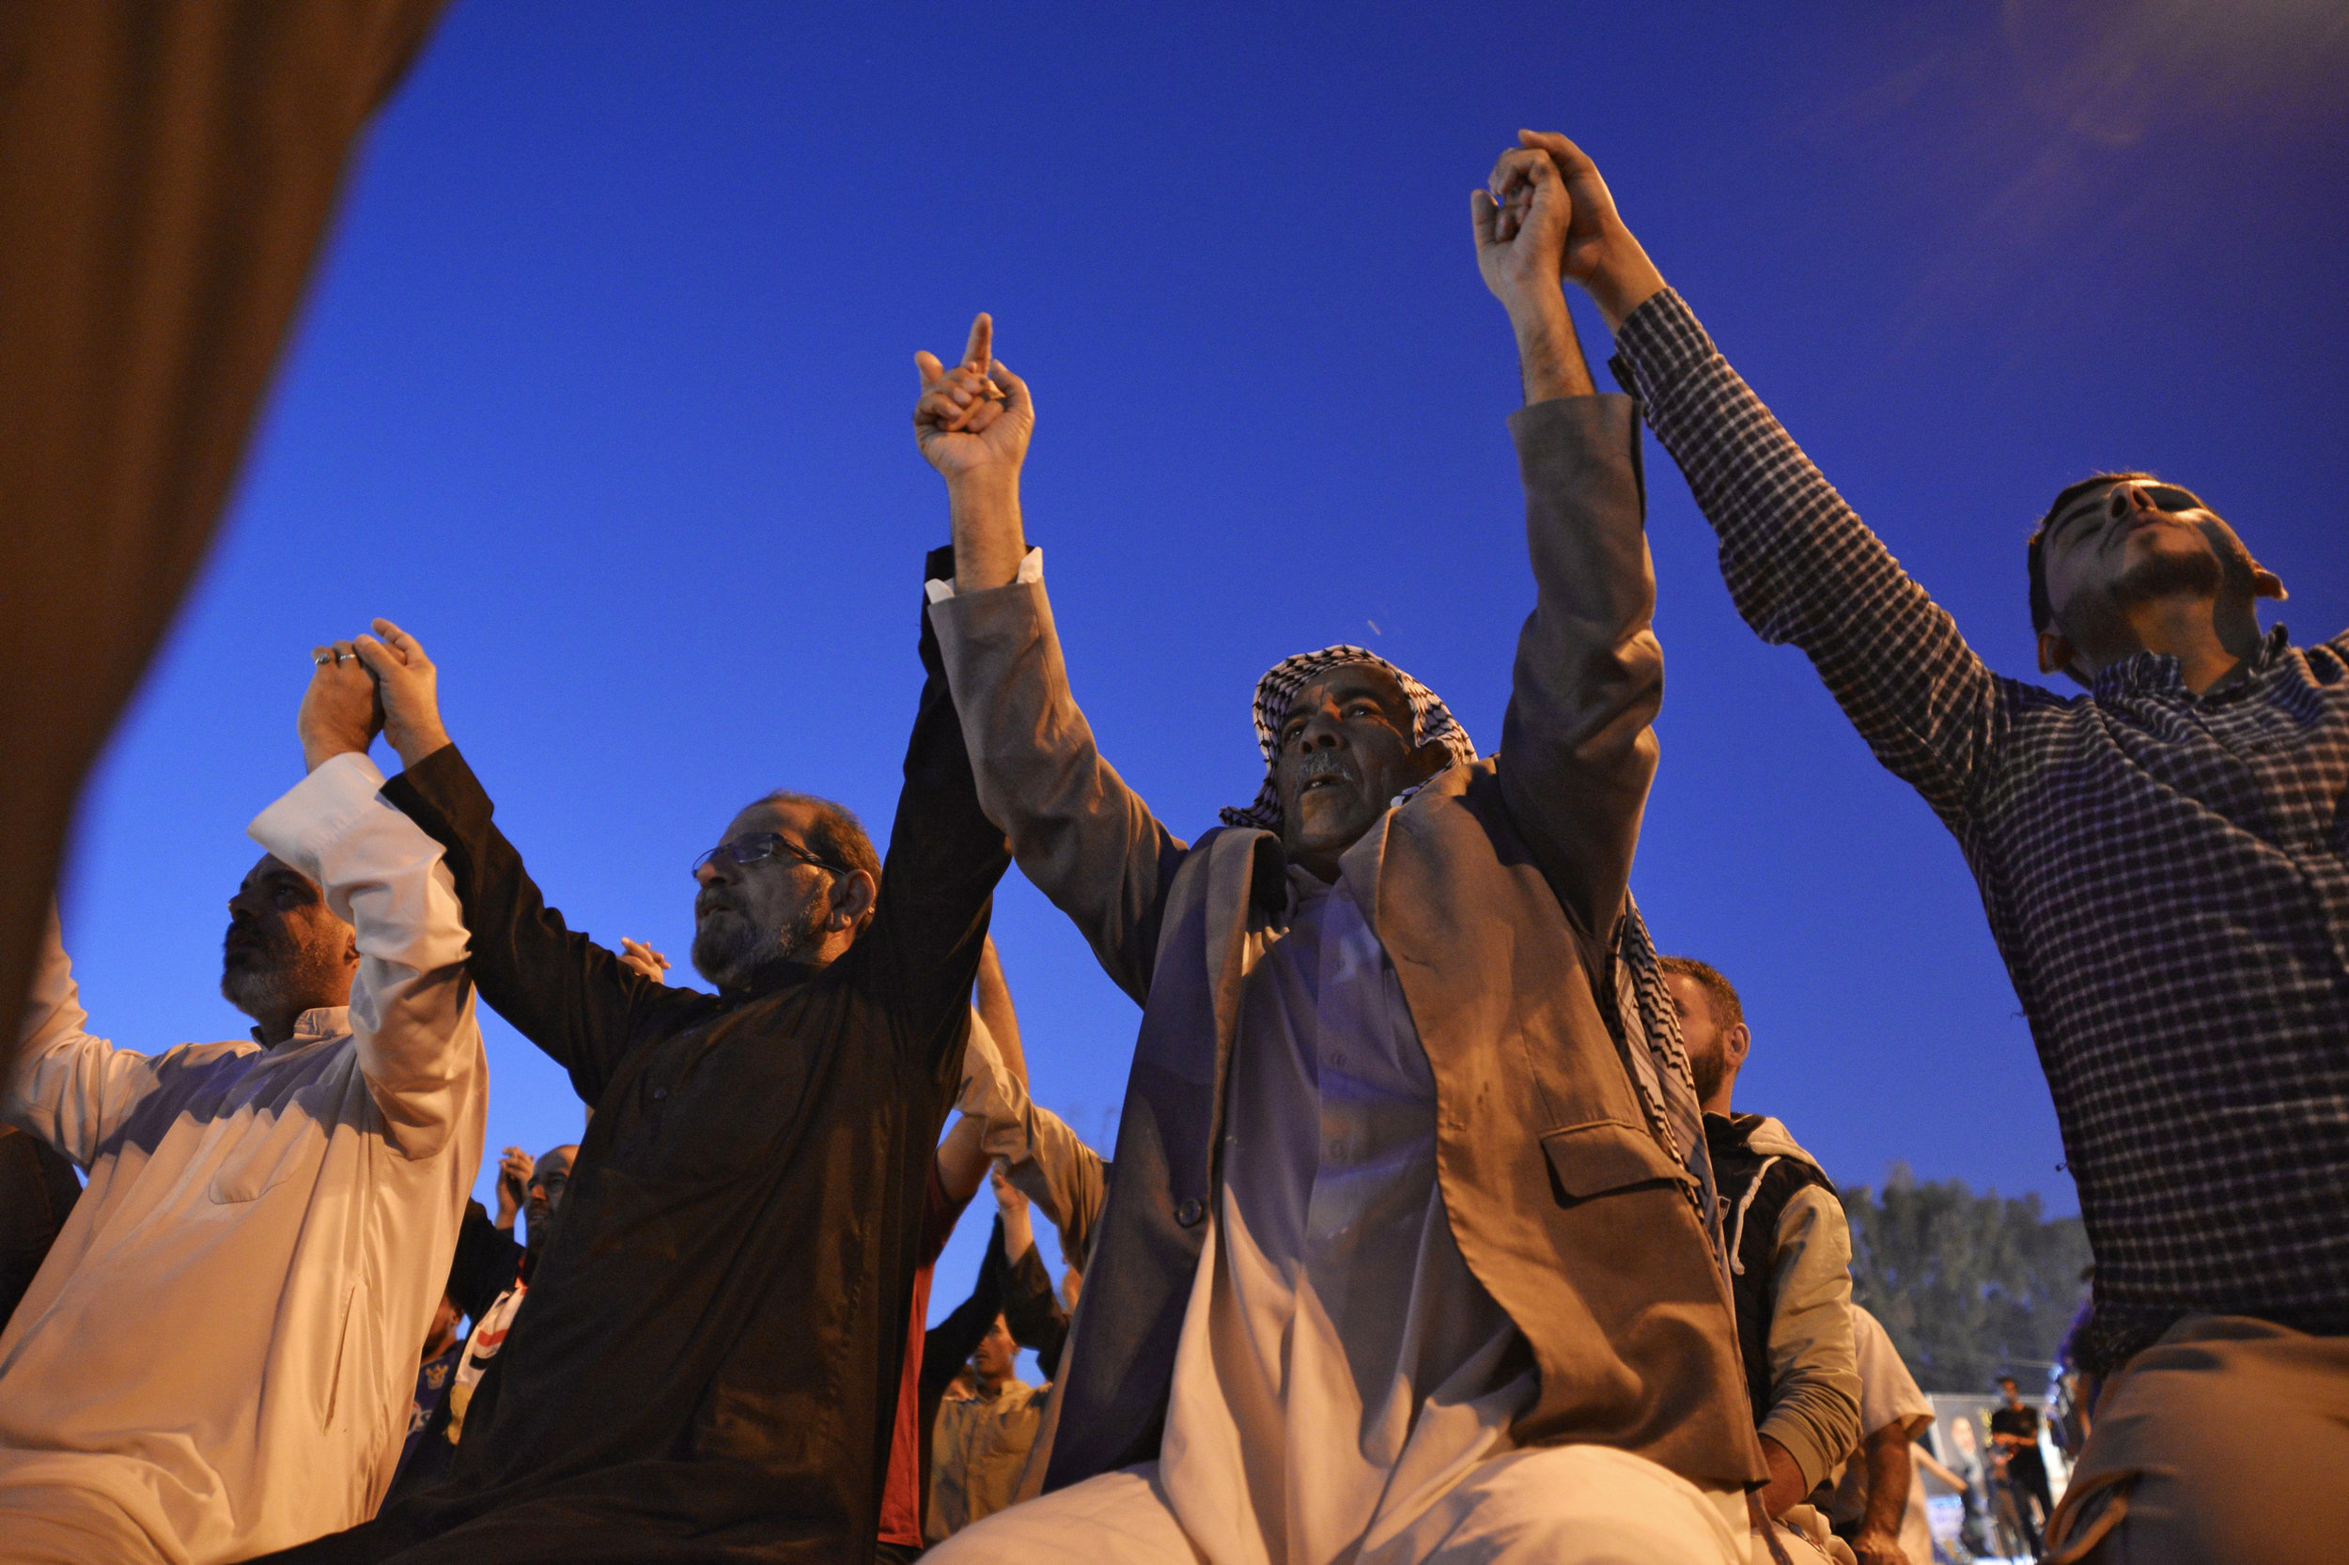
Protests from around the world
A protester waves a red flag in front of anti-riot police in Rome in October 2011. Tens of thousands marched as part of a global day of protests inspired by Occupy Wall Street.
Amid fires set around Independence Square, known as the Maidan, in Kyiv, Ukraine, protesters demonstrate against the government of then-President Viktor Yanukovych in February 2014.
In November 2015, a man walks amid hundreds of shoes in Paris, left to protest climate inaction after marches were banned following terrorist attacks.
Iraqi protesters join hands after taking part in prayers during anti-government demonstrations in the Shiite holy city of Najaf, in November 2019.

Slide 9
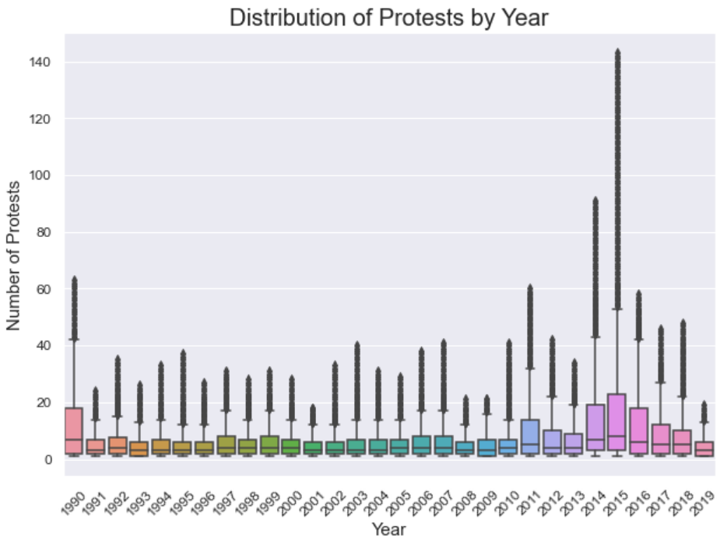
EDA - Protests over Time(worldwide)
Notes:
To begin, we have a simple arrangement of boxplots showing the number of protests, worldwide, by the years available in our dataset

Slide 10
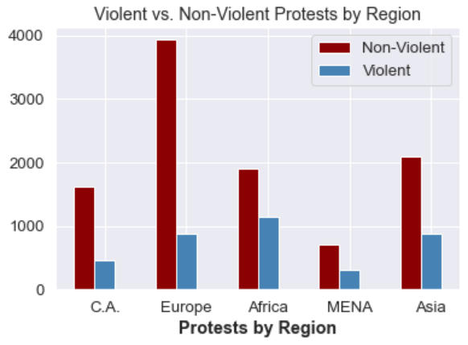
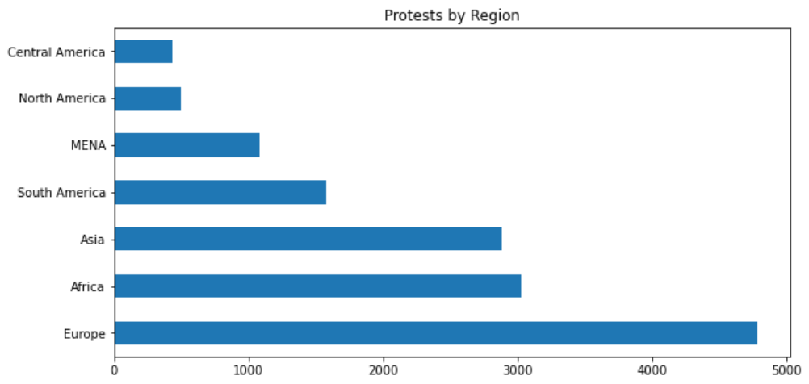
EDA (cont.)
Protests by Region and the amount of protests by year (Worldwide).
Notes:
Here we can see the total protests by region in the lower left and the amount of Non-Violent vs. Violent protests in each of these regions just above. The majority are non-violent...with the closest correlation being in Africa.

Slide 11
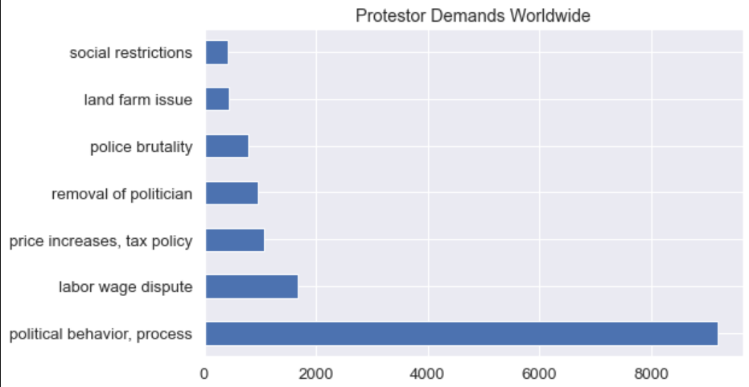
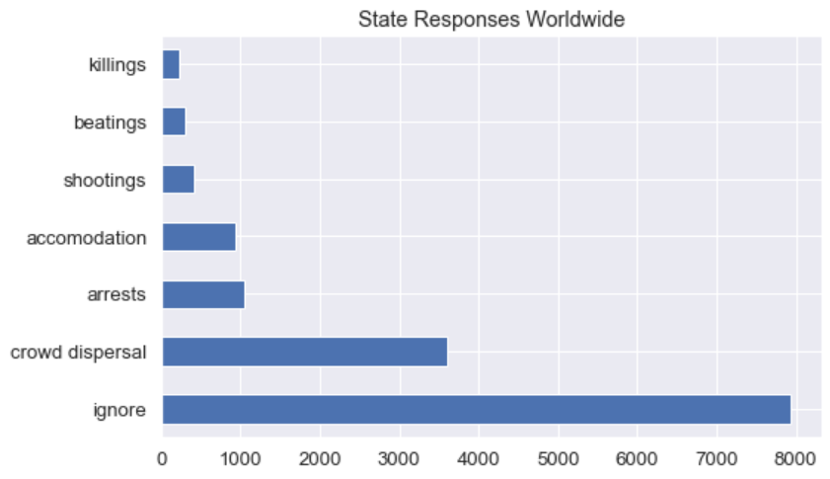
EDA (cont.)
State responses, worldwide, vs. the protesters’ demands.
Notes:
As you can see here, the majority of the demand of protests were political behavior -- but at the same time and apparently equally so, these demands were ignored by the state in which the protests were held.

Slide 12
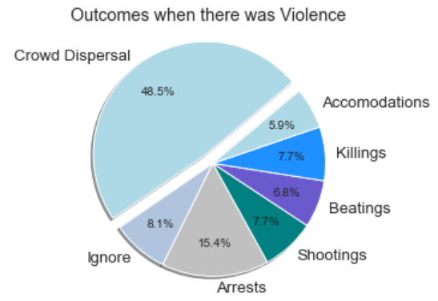
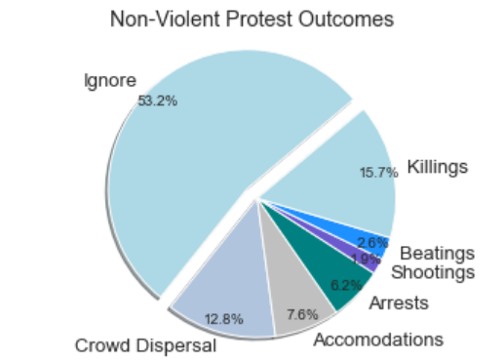
EDA (cont.)
The differences in state responses/outcomes to violent vs. non-violent protests can be seen here. It’s quite interesting to note the enormous difference in the protest being ignored when it is peaceful vs. not (along with other interesting comparisons).
Notes:
Very interesting to see how much violence decreases the amount of subjects being ignored, while also having (understandably) the most crowd dispersal and yet, somehow, non-violent protests appear to have more killings.

Slide 13
Models Used
4 Models
for
7 Regions
Notes:
The following slides will display the 4 models we used for each of the 7 regions
We ran each model for each of the 7 target variables (responses)
Because this gives us 196 different results, our most significant findings will be presented in the following slides

Slide 14
1. Random Forests
Baseline Score = 83.56%
Training Score (mean) = 98.23%
Testing Score (mean) = 88.75%

Slide 15
2. Support Vector Classifier (SVC)
Baseline Score = 83.56%
Training Score (mean) = 98.36%
Testing Score (mean) = 88.79%

Slide 16
3. Logistic Regression
Baseline Score = 83.56%
Training Score (mean) = 97.84%
Testing Score (mean) = 88.28%
Lasso and Ridge both effective

Slide 17
4. XGBoost
Baseline Score (7 reponses) = 83.56%
Baseline (4 target responses) = 74.5%
Training Score (mean) = 97.02%
Testing Score (mean) = 89.15%

Slide 18
Model Demonstration!

Slide 19
Conclusions/Recommendations
Baseline scores can be hard to beat - specifically the violent responses
...But we can predict with confidence (e.g. beat the baseline) for most other responses!
Successful Models
Logistic Regression, XGBoost

Slide 20
Thank you
Questions?

Slide 21
Sources
Mass Mobilization Dataset:
https://massmobilization.github.io/visualization.html
Slides template: https://slidesgo.com/
https://www.npr.org/sections/pictureshow/2019/12/31/790256816/the-2010s-a-decade-of-protests-around-the-world

